Slide 1
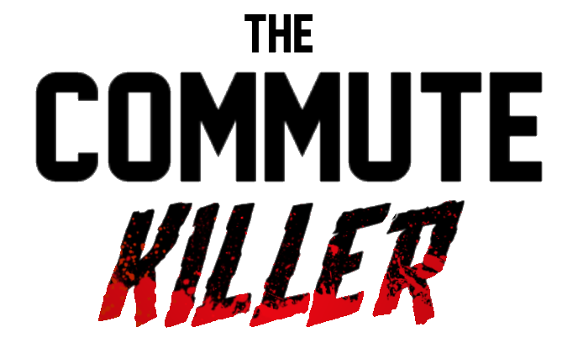
Please, mind the gap!

Slide 2
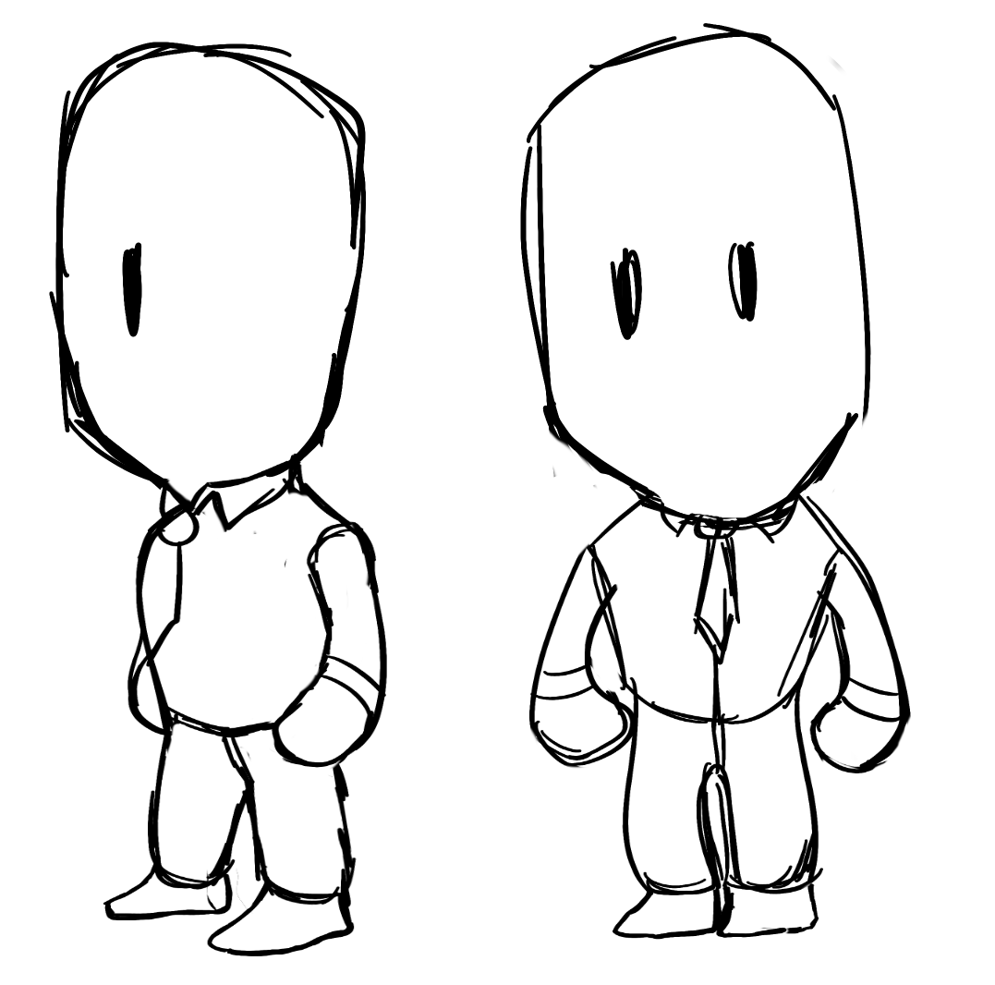
Premisse
A former private detective turned hitman stalks his targets on their commutes. He must gather information and leverage his assets to fulfill each contract in the most expedient and covert way possible.
Concept art of a character in game

Slide 3
Design Goals
Tension - a careless or rushed playstyle will get the player caught, they must remain hidden or the job might just become impossible;
Immersion - interesting targets and an overarching underlying story that will leave you wanting to learn more;
Rewarding - the narrative development and evolving gameplay (new equipment and/or available mechanics) aim to give the player a clear sense of progression;
Challenging Gameplay - increasingly complex level designs that nevertheless allow for a variety of creative solutions.

Slide 4
Audience, Genre and Platforms
The target audience is PC/Console players, namely teenagers and young adults that enjoy puzzle and strategy with a focus on storytelling;
People who have a good time solving challenges and unravelling secrets;
Fans of cute cartoon violence;
Targeting the PC market primarily and consoles secondarily.

Slide 5
Gameplay Features
Main Locations: Office and Street;
In the Office there is a city map and the player has a notebook, in both you can find all the information discovered;
The notebook contains a contacts list of special people; Help has a cost!
Each contract has a deadline and some initial information on the target;
Per each job well done, the player receives a reward (bonus depends on the time left);
The player can follow the target, stalk them through a telescope, analyse CCTV footage, etc;
To assassinate the target, the player can interact with elements in the scene (cars, people, etc)
The Office has some equipment that helps in the assassination and obtaining information (eg: night-vision goggles, costumes etc);

Slide 6
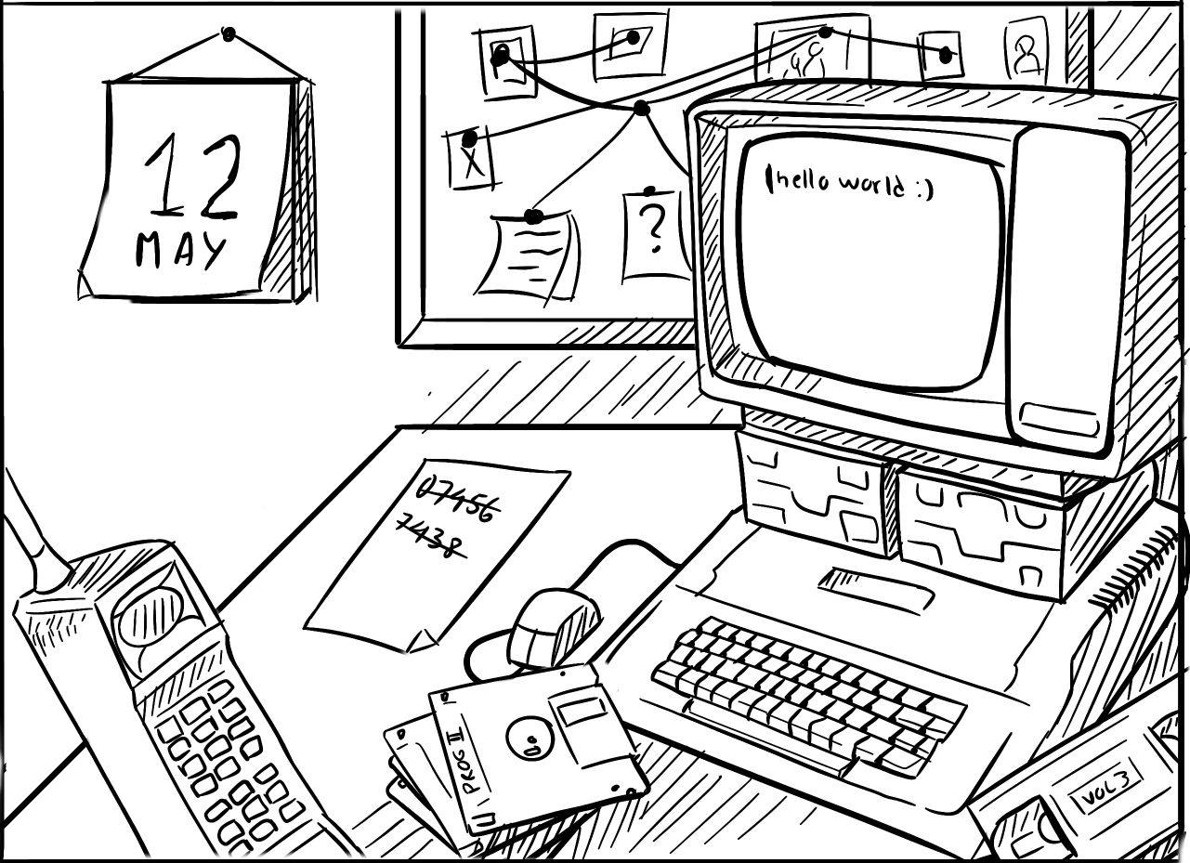
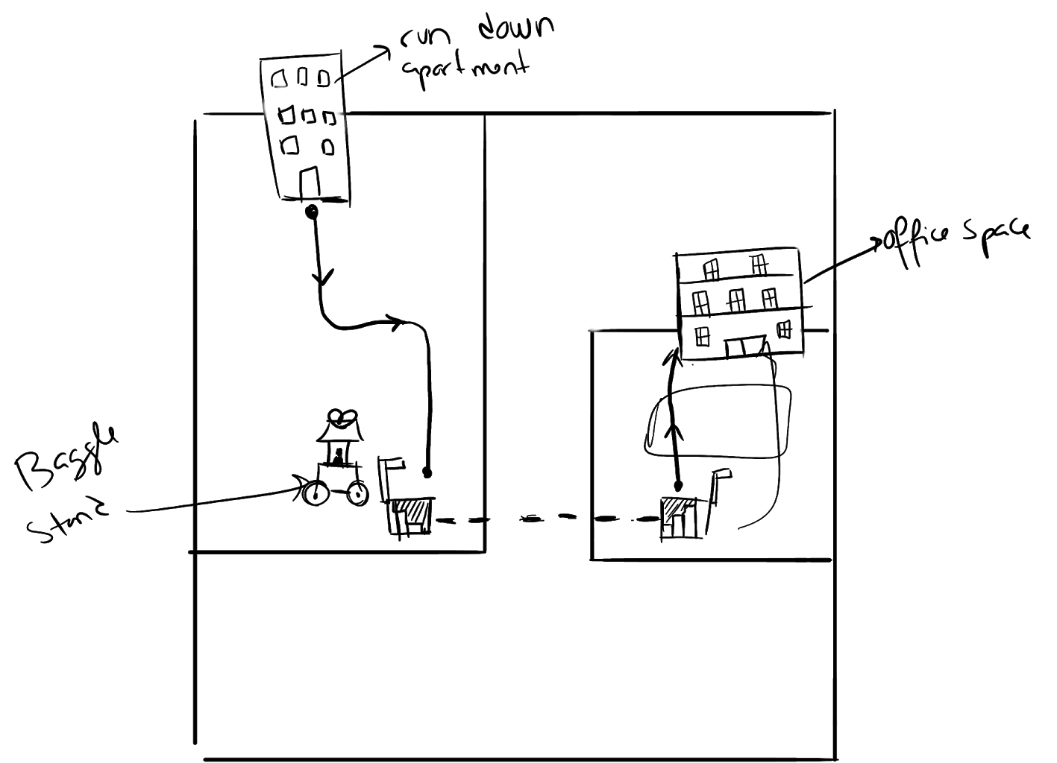
Visual Examples
Example of a level map layout
Example of 1st person view in the office

Slide 7
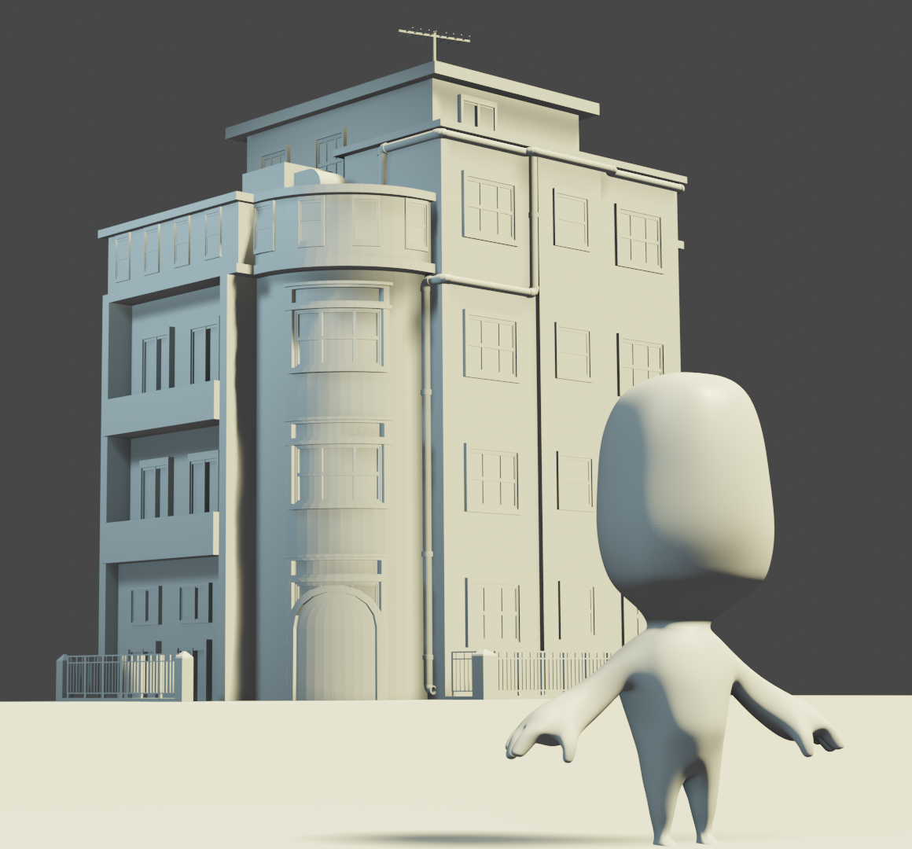
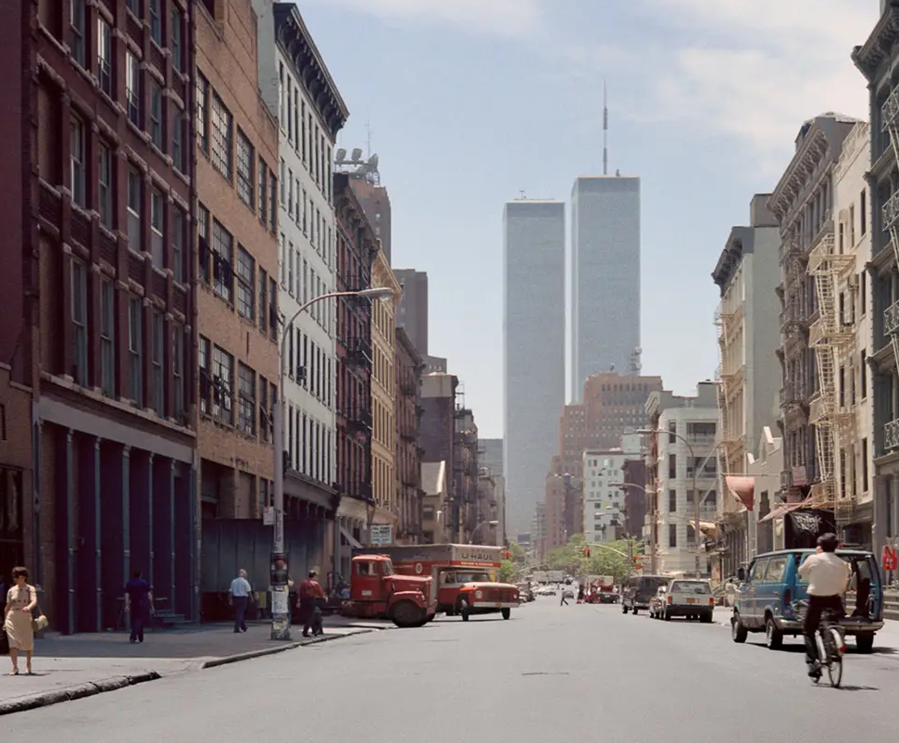
Look and Feel
Models we created to explore art style
New York in the 1980s for reference

Slide 8
Overview
Key Commercial Considerations
Targets smaller audience due to the presence of violence and adult topics.
However it features a theme that might appeal to people, and that can help increase its visibility in a saturated market.
Simple art style instead of more detailed realistic look allows for cheaper and faster development.

Slide 9
Overview
Key Design Considerations
Inducing sense of challenge upon tackling a new level as well as satisfaction upon solving it. Reward creativity. Make sure challenge scales proportionally.
Getting players enthused about uncovering the story. Finding the connection between the events.
Establish a clear aesthetic that is reminiscent of the period (late 80s/early 90s) with the use of a simplified cartoon art style.
Employ the use of Analog and old digital technology. Unique interactions plus differentiate from games that feature high-tech spy gadgets.

Slide 10
Overview
Player Motivation
Initial fun comes from sense of wonder created by the exploration of the map and the things you can do within it;
The town is full of life and features lots of props to interact with as well unique events that trigger special situations which can alter the terrain or crowd behaviour;
New mechanics, tools and more complex and challenging scenarios keep the player curious to see what comes next;
An emerging storyline (uncovered by seeking clues) gives meaning to the events and motivates players to look carefully for answers;

Slide 11
Overview
Competition
The game has some similarities to games like “Hitman” (strategy assassination gameplay) and “Detective Grimoire” or “Deponia” (storytelling and deduction mechanics);
Games with storytelling in investigation/assassination scenarios, with planning/strategy mechanics or puzzle games;
Unique Selling points:
Spin on the detective/hitman style of game by highlighting narrative instead of gun-play ;
Main focus is getting the information and drafting the plan, not the kill itself;
The simple cartoon art style brings levity to a typically heavy thematic, setting it apart visually;

Slide 12

Thank you

